Slide 1
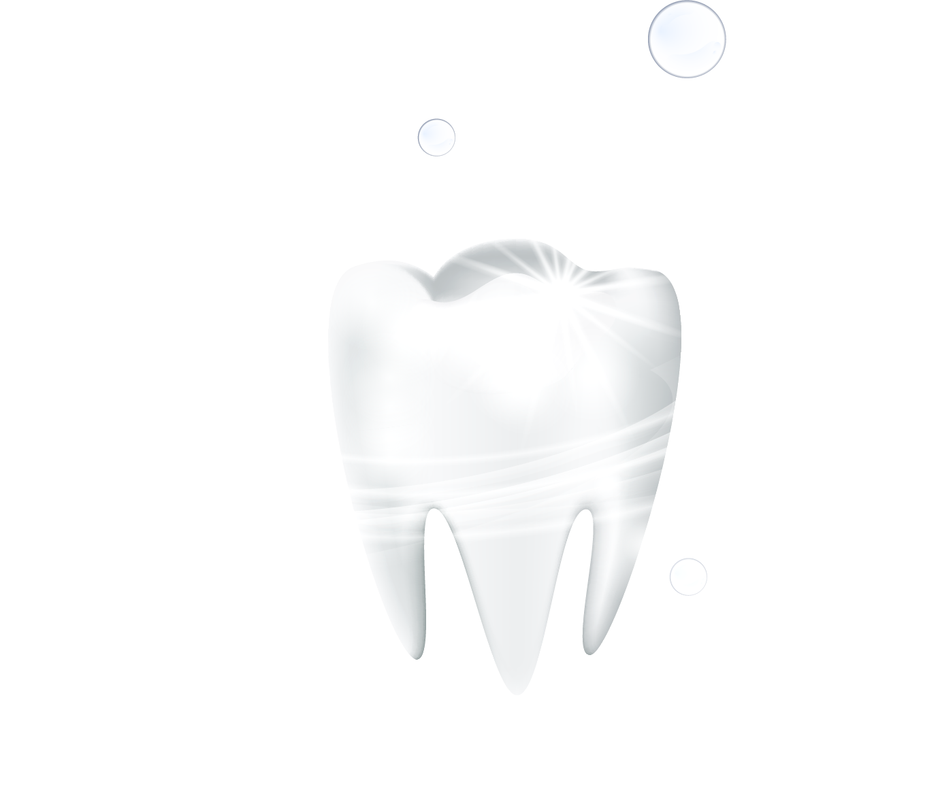
Improved Integrated Deep Learning Framework with Support Vector Machine for Dental Health Analysis

Slide 2
Abstract
This project presents an improved deep learning framework for dental health analysis using dental X-ray images. The main objective is to classify teeth into healthy and non-healthy categories, where non-healthy includes cavities, fractures, and impacted teeth. Existing models such as CNN and other deep learning approaches provide good performance; however, they have limitations like overfitting, high computational cost, and lower generalization ability. In this study, models including CNN, ResNet50, ResNet101, DenseNet121, and VGG16 are used for comparison. To enhance performance, a hybrid model combining ResNet50 for feature extraction and SVM for classification is proposed. The proposed ResNet50+SVM model achieves higher accuracy and better overall performance compared to the other models..

Slide 3
Introduction
Oral health is important for overall health and quality of life.
Dental problems like cavities, fractured teeth, and impacted teeth are common and can cause serious issues if not detected early.
Dentists use dental X-ray images to identify these problems, but manual analysis can be time-consuming and may lead to errors.
In our project, we classify dental X-ray images into two categories: Healthy and Non-Healthy
If a tooth has cavities, fractures, or is impacted, it is classified as Non-Healthy; otherwise, it is Healthy.
We compared different deep learning models such as CNN, ResNet50, ResNet101, DenseNet121, and VGG16.
Our proposed hybrid model, ResNet50 + SVM, achieved better performance compared to the other models.

Slide 4
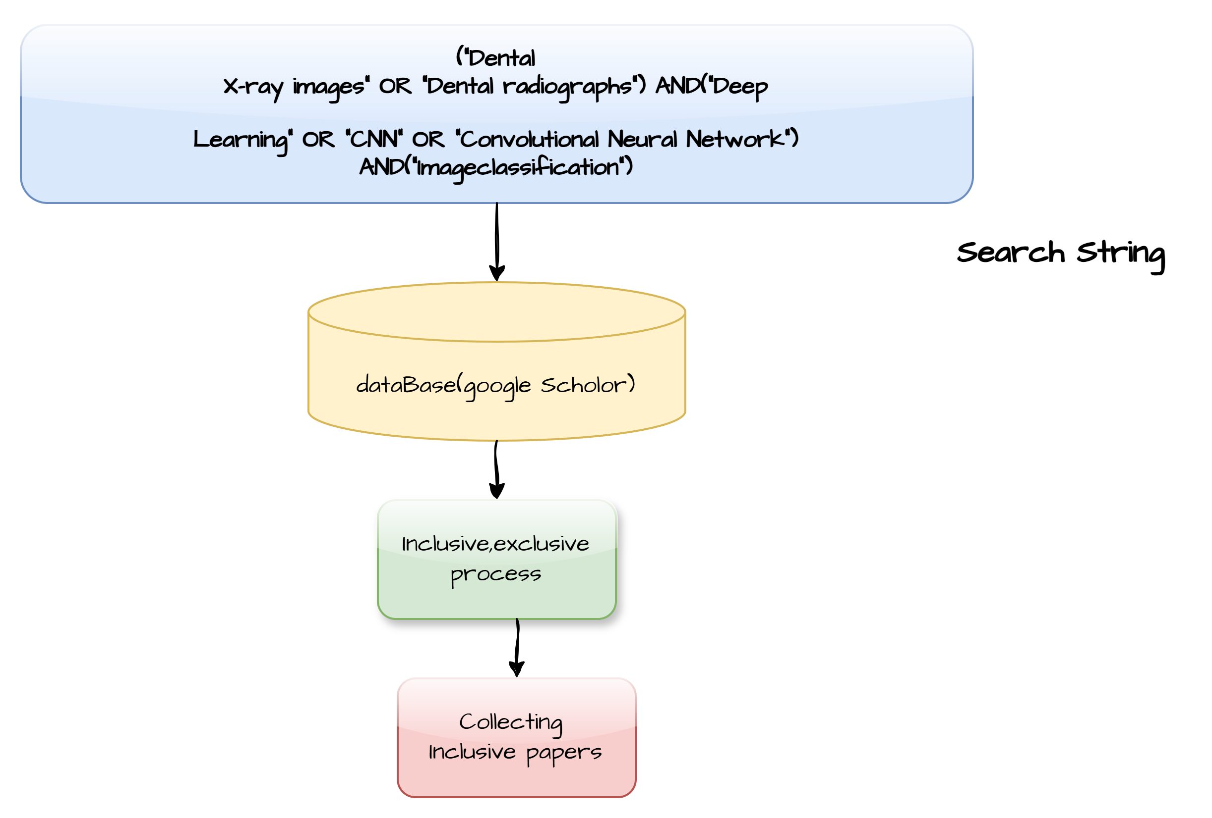
Literature Review

Slide 5
Literature Review
Year | Title | dataset | Compared models | Proposed Model | Performance metrics | Authors
2020 | A Performance Comparison between automated Deep Learning and Dental Professionals in Classification of Dental Implant Systems From Dental Imaging | 11,980 panoramic and periapical radiographic images | DCNN | DCNN | Specificity=85.3 Recall=95.5 | Jae-Hong Lee et al.
2020 | Deep Neural Networks for Dental Implant System Classification | 8859 manually cropped implant images collected from Kagawa Prefectural Central Hospital, Japan | CNN,VGG16(transfer Learning),VGG16(Fine-Tuned),VGG19(Transfer Leaning),VGG19(Fine-Tuned) | Fine-Tuned VGG16 | Accuracy-93 Precision-93 Recall-93 F1-score-93 | hintaro Sukegawa et al.

Slide 6
Year | Title | Dataset | Compared Models | Proposed Model | Performance Metrics | Authors
2021 | A unified Convolutional Neural network for dental Caries Classification | Dental X-ray images collected from Kaggle dataset. | Unified CNN,Traditional CNN,pre-ttrained models | Unified CNN | Accuracy=93 F1-score=92 | Golkarieha et al
2023 | Classification of Dental Teeth X-Ray Images Using a Deep Learning CNN Model | Panoramic Dental X-rays(116 patients, 3712 single tooth images) | NasNetMobile+CNN+SGD | NasNetMobile+CNN+SGD | Accuracy=84% | Dankai Liao And Carol Anne Hargreaves

Slide 7
year | Title | Dataset | Compared Models | Proposed Models | Performance Metrics | Authors
2023 | An Explainable Deep Learning Model to Prediction Dental Caries Using Panoramic Radiograph Images | Dental Datasets | EfficientNet-B0 DenseNet-121 ResNet-50 | ResNet50 | Accuracy=92 Sensitivity=87.33 F1-score=91.61 | Faruk Oztekin et al.
2023 | Automated deep learning for classification of dental implant radiographs using a large multi-center dataset | 156,965 panoramic and periapical radiographic images | DL model | DL model | Accuracy=88.53 Precision=85.70 Recall=82.30 F1-score=84 | Wonse Park et al.
2023 | Periodontal Disease Classification with Color Teeth Images Using Convolutional Neural Networks | 220 frontal tooth images collected over the internet. | CNN,ResNet52 | CNN | Accuracy=74.54 | Park et al.

Slide 8
Year | Title | Dataset | Compared Models | Proposed Models | Performance Metrics | Authors
2025 | Advanced Deep Learning Techniques for Classifying Dental Conditions Using Panoramic X-Ray Images | obtained from the Roboflow platform, comprising panoramic dental X-ray images annotated for multiple dental conditions | CNN,CNN+DT,CNN+RF,CNN+SVM,VGG16,ResNet50,Xception | CNN+RF | Accuracy=85.4 Macro Precision=84.7 Macro Recall=83.9 Macro f1-score=84.3 | Alireza Golkarieh, Bahareh Afjehsoleymani et al.
2025 | A Comprehensive Deep Learning Framework for Dental Disease Classification | Clinically sourced dental image dataset (10,573 images) | 5-layer CNN,3-layer CNN,EfficientNet,ResNet50 | 5-layer CNN | Accuracy=87.6 Precision=86.2 Recall=85.4 F1-score=85.8 | Parkhi et al.,

Slide 9
Observations
Most existing models rely only on CNN with Softmax, which may cause overfitting and weak class separation.
Many studies do not use a hybrid approach combining deep learning with machine learning.
Several models focus mainly on accuracy and ignore balanced performance metrics like recall and F1-score.
Our model replaces Softmax with SVM, providing stronger decision boundaries and better generalization.
Our hybrid approach (ResNet50 + SVM) improves classification performance compared to single CNN models.
Our model achieves balanced accuracy, precision, recall, and F1-score for reliable healthy vs non-healthy classification

Slide 10
Proposed Model
The proposed model uses a hybrid deep learning–based approach for automated dental disease classification.
A pre-trained CNN architecture (ResNet-based feature extractor) is used to extract high-level image features.
Extracted features are optimized using a machine learning classifier for improved prediction performance.
The model achieves improved accuracy, precision, recall, and F1-score compared to existing baseline models.

Slide 11
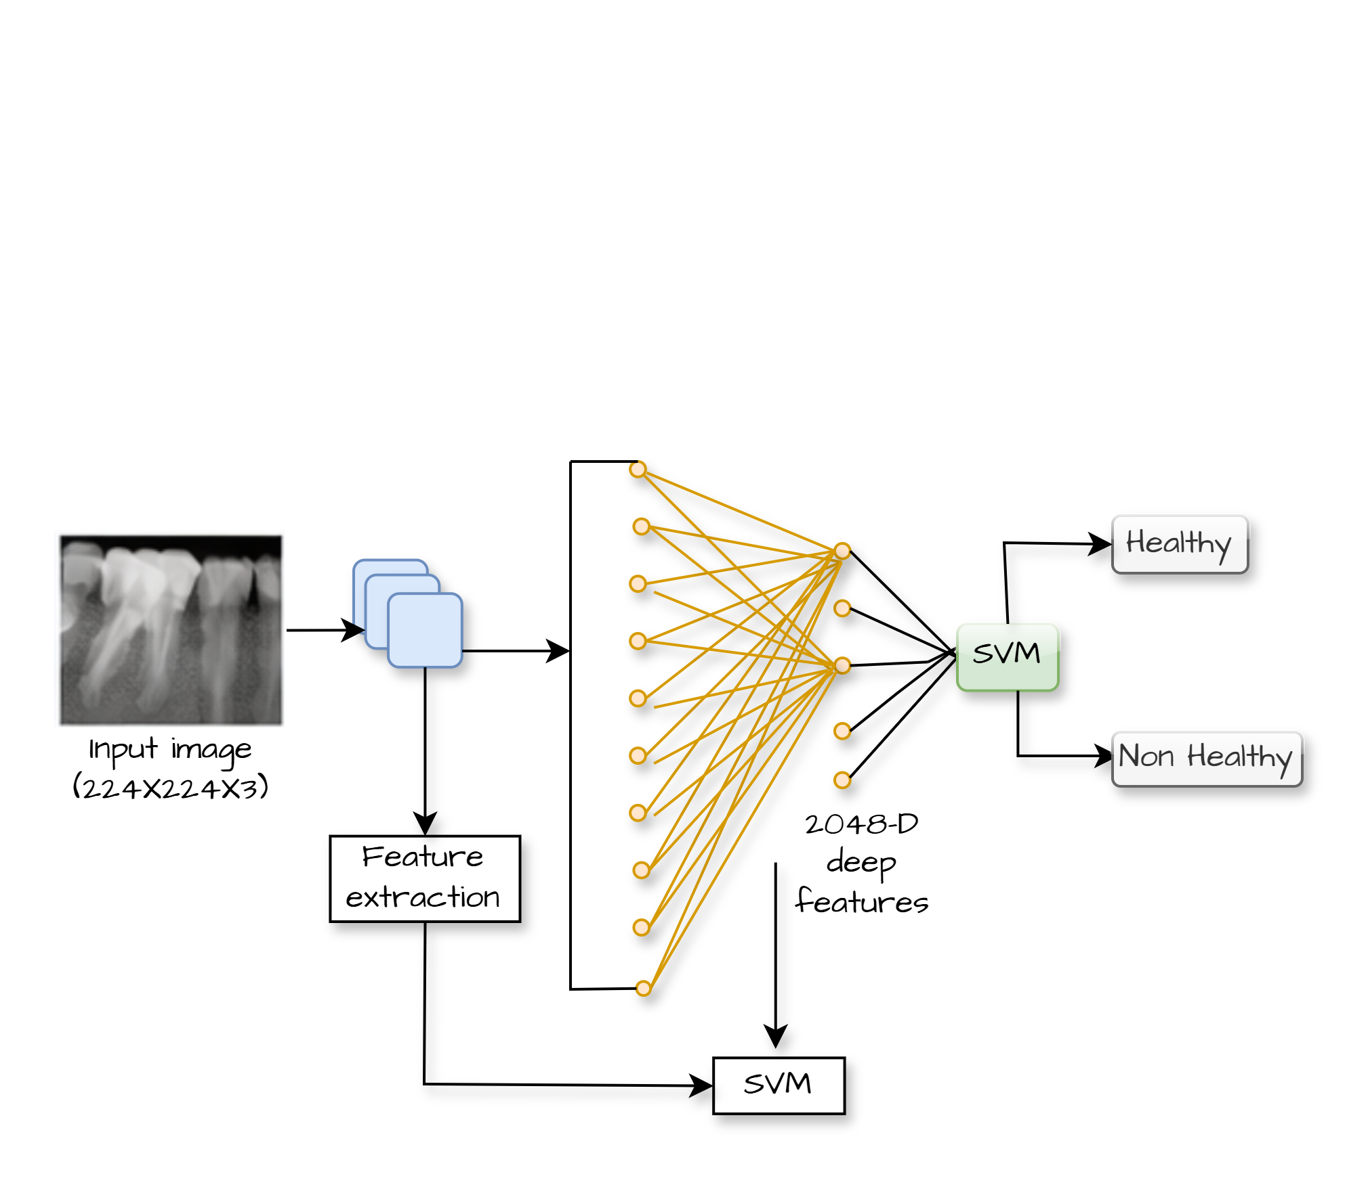
Architecture of ResNet50+SVM

Slide 12
Dataset used
The dataset used in this project is the Dental Object Detection X-Ray Dataset obtained from Kaggle.
It contains 1,650 labeled panoramic dental X-ray images.
The images are annotated for different dental conditions.
From the labeled images, individual teeth regions were cropped
After cropping, we extracted 6,937 tooth samples.
This increases the dataset size and improves model training.
Dataset Splitted into Traing and testing Datasets
Training Set: 5,474 samples
Testing Set: 1,463 samples
Class Distribution
we Classified the dataset into two classes
1.Healthy
2.Non-Healthy(Cavities,fractured,Impacted)

Slide 13
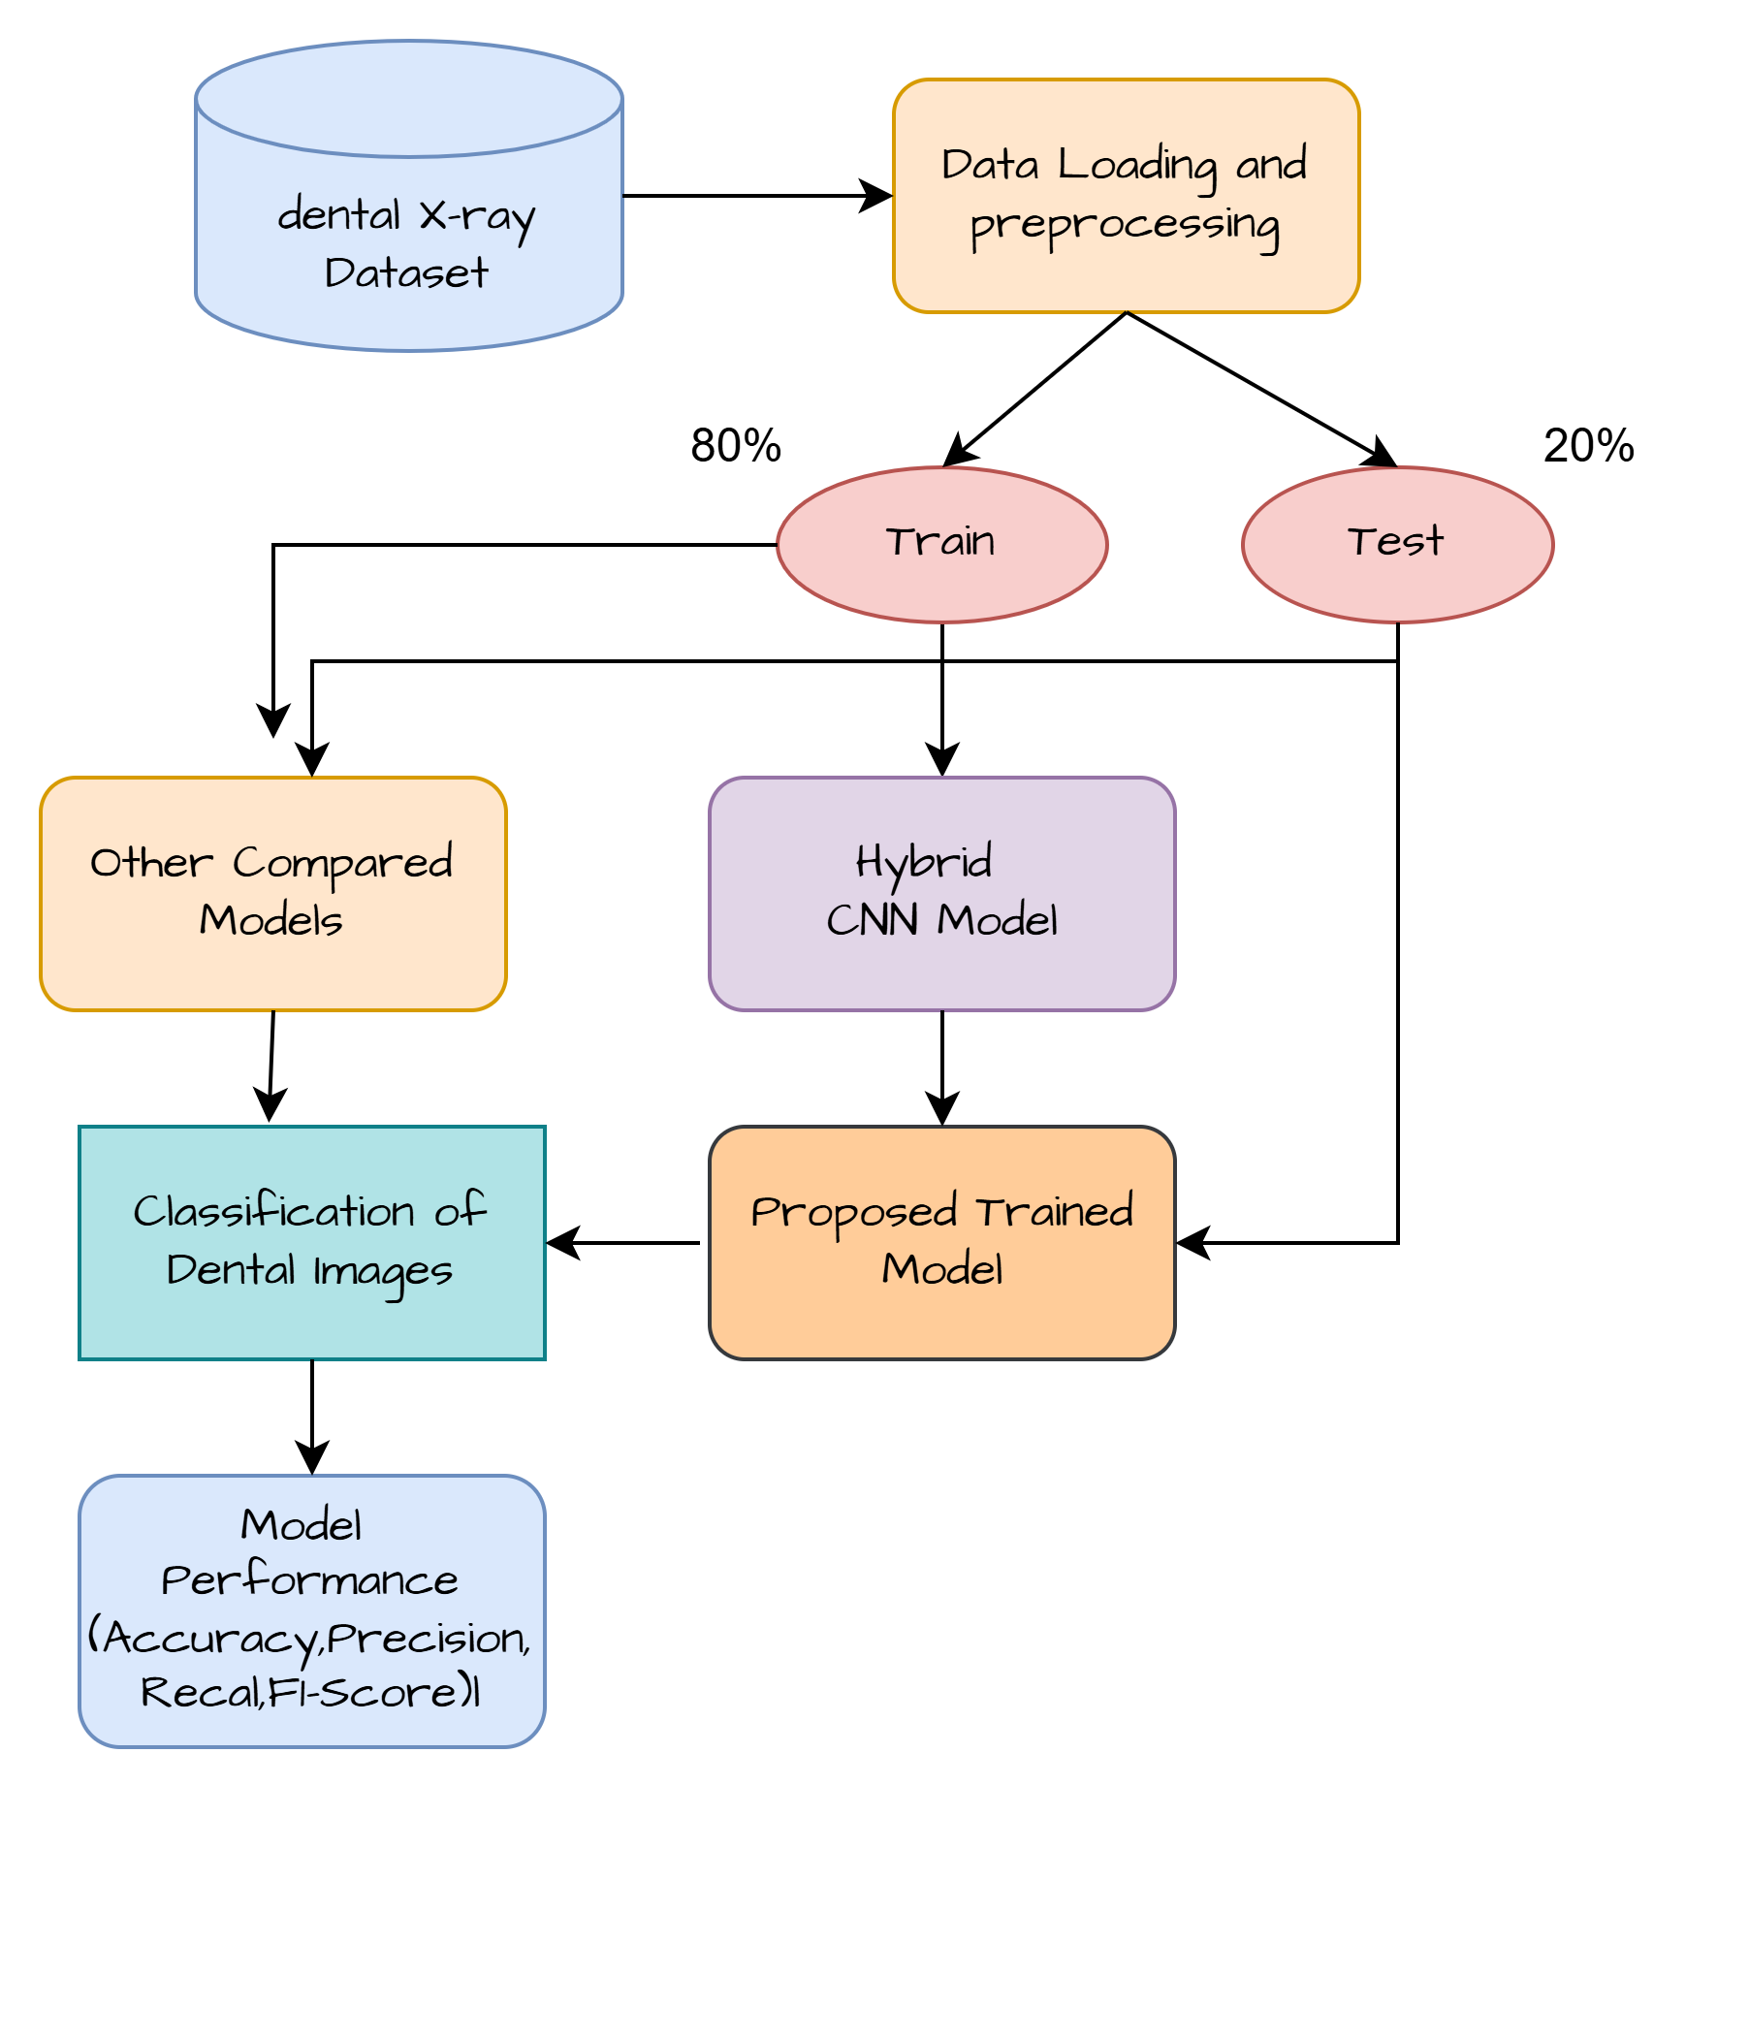
Methodology

Slide 14
Implementation process
Collected and preprocessed dental images (224×224 resizing).
Applied ResNet50 as feature extractor.
Extracted 2048-dimensional deep features using Global Average Pooling.
Normalized features using StandardScaler.
Classified images using SVM (RBF kernel) for final prediction.
Evaluated model using Accuracy, Precision, Recall, F1-score, Confusion Matrix & ROC Curve.

Slide 15
Comparison models
The following deep learning models were used for comparative analysis:
Convolutional Neural Network (CNN):
CNN can automatically extracts image features without manual feature engineering but it Can overfit and may not capture very deep complex patterns.
ResNet50:
In ResNet50 Residual connections allow deep feature extraction without vanishing gradient.but Computationally heavy and still relies on
Softmax for final classification.
ResNet101:
In ResNet101 Deeper network captures more complex image features but Very high training time and increased risk of overfitting.

Slide 16
VGG16:
Simple and effective architecture for transfer learning. But Large number of parameters and
high memory usage.
DenseNet121
Reuses features efficiently through dense connections. But Complex architecture with higher
computational cost.
Proposed Model (ResNet50 + SVM)
Uses ResNet50 to extract powerful deep features, Replaces Softmax with SVM, which creates a
stronger decision boundary , Reduces overfitting compared to deep-only models. And Provides
better generalization for Healthy vs Non-Healthy classification

Slide 17
Metrics of comparison models
 | CNN | VGG16 | ResNet50 | ResNet101 | DenseNet121 | Resnet50+SVM
Accuracy | 0.796308 | 0.79289 | 0.830485 | 0.821599 | 0.773069 | 85.85%
precision | 0.774271 | 0.77902 | 0.827676 | 0.817945 | 0.806451 | 85.87%
Recall | 0.850666 | 0.83222 | 0.845333 | 0.838666 | 0.733333 | 85.81%
F1-Score | 0.810673 | 0.80464 | 0.836411 | 0.828276 | 0.768156 | 85.83%

Slide 18
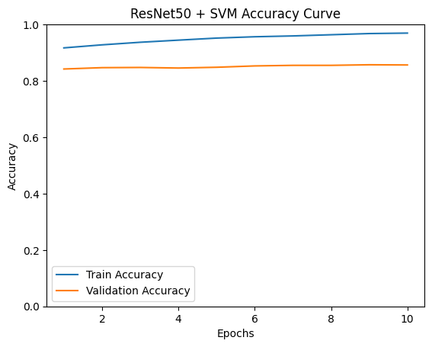
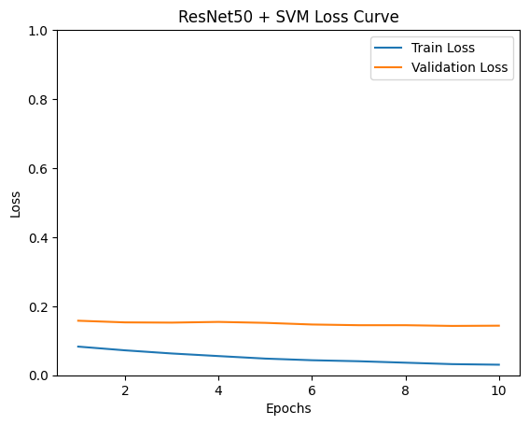
Results

Slide 19
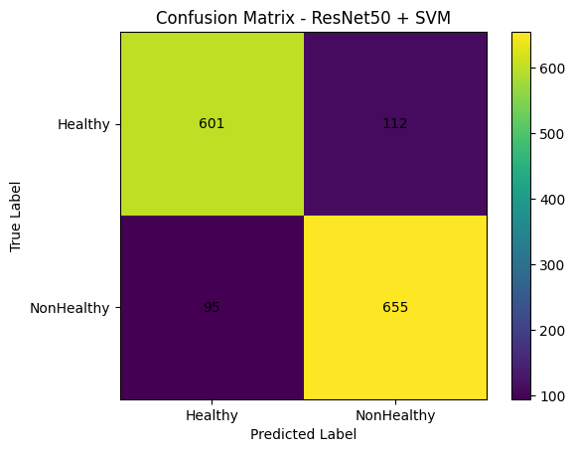
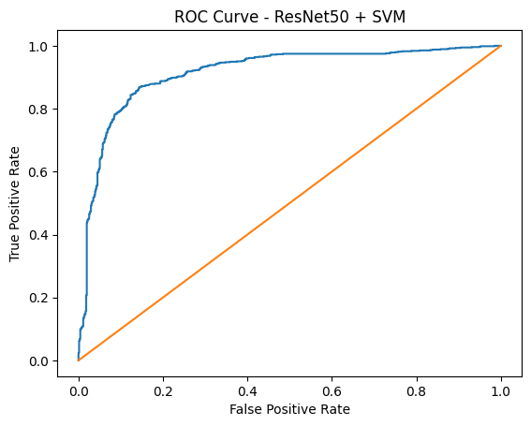

Slide 20
Requirements
Hardware Requirements
•Processor: Intel i5 or above
•RAM: Minimum 8 GB (16 GB recommended)
•Storage: At least 20 GB free space
•GPU: T4 GPU
•Internet: Required for Google Colab or downloading libraries
•System: Laptop or desktop computer
Software Requirements
•Operating System: Windows
•Programming Language: Python
•Platform: Google Colab
•Deep Learning Libraries: TensorFlow, Keras
•Machine Learning Library: Scikit-learn
•Data Processing Libraries: NumPy, Pandas
•Visualization Libraries: Matplotlib, Seaborn

Slide 21
Future Scope
Increase dataset size to improve model accuracy and generalization.
Extend the model to multi-class classification (caries, fracture, impacted, etc.).
Deploy the system as a web or mobile application for real-time use
Implement real-time dental X-ray analysis in clinics.
Improve performance using ensemble learning techniques.
Expand to detect additional oral diseases like periodontitis and gum infections.

Slide 22
Conclusion
This project uses deep learning to automatically detect dental health from dental X-ray images. We used a pre-trained ResNet50 model to extract important features from the images, and then used an SVM classifier to make the final prediction. The model achieved good accuracy, precision, recall, and F1-score, showing that the method works well. When compared with other models, our approach gave reliable and stable results. Overall, this system shows that our proposed model can help dentists by giving faster, more accurate, and consistent diagnosis.

Slide 23

🦷
Thank You
🦷
Any Suggestions?

